Slide 1
Aniket Prakash Mishra- Mastering Tableau Project
File created on: 4/12/2022 8:57:03 PM

Slide 2
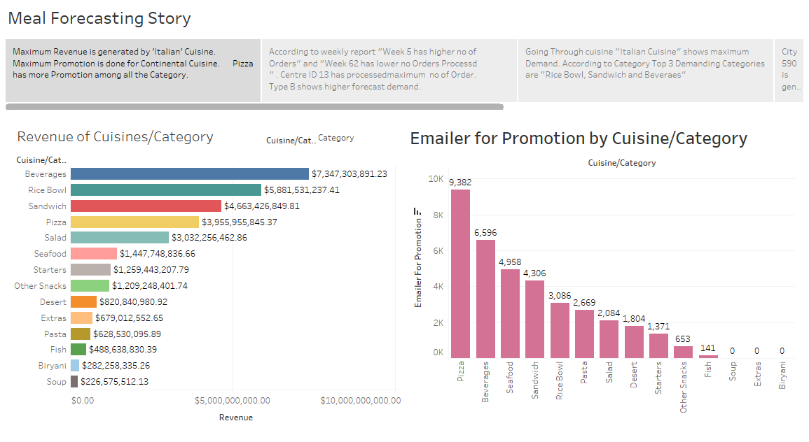

Slide 3
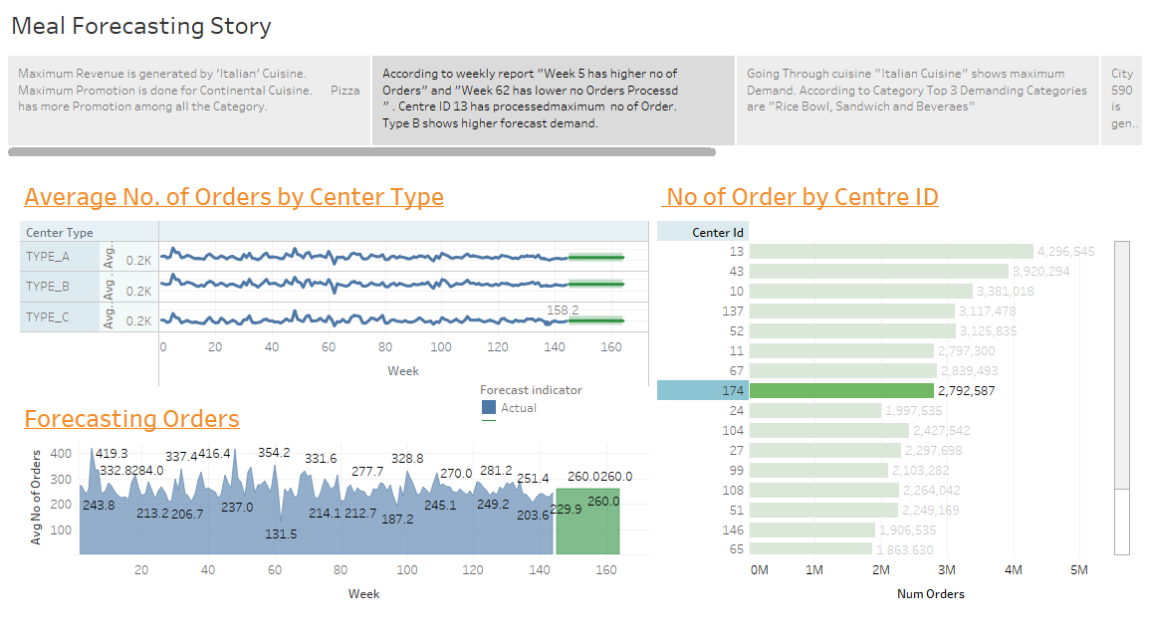

Slide 4
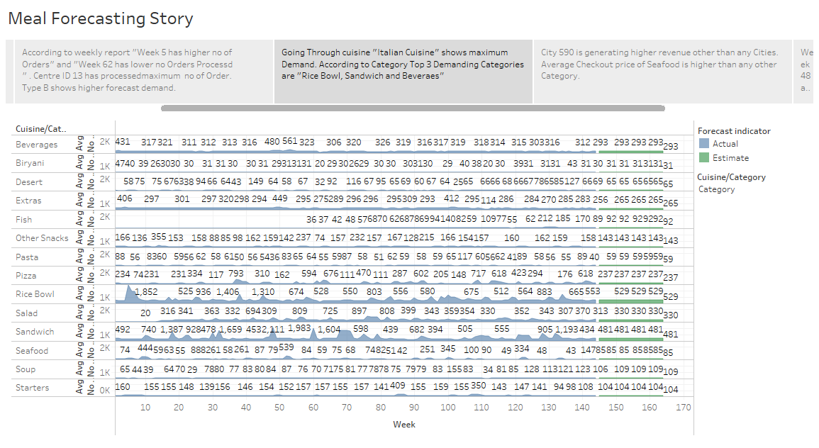

Slide 5
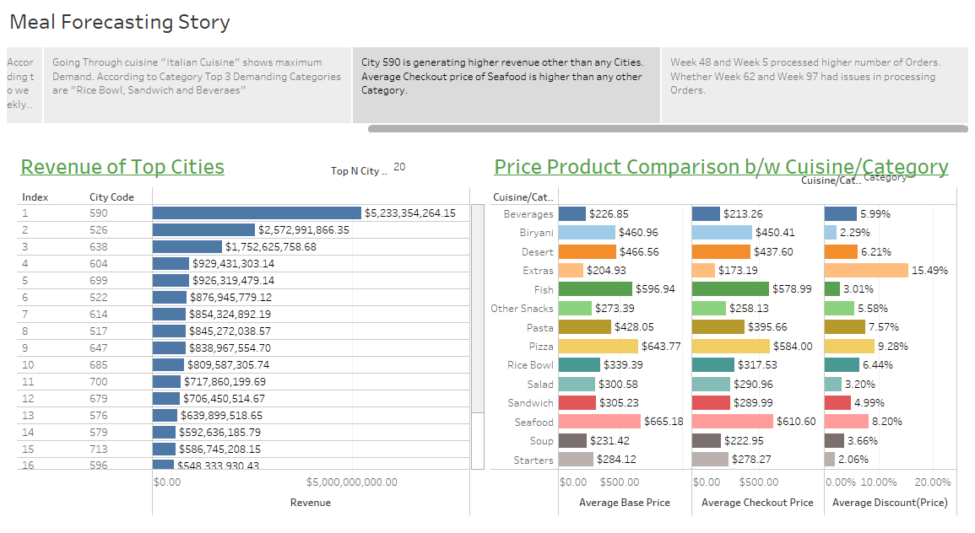

Slide 6
